Slide 1
Tan Cang Haiphong International Container Terminal
Welcome the delegation
from Regional Container Lines
Hai Phong, May 2023
Notes:
Thêm Edo
Thêm sản lượng các line 6 tháng

Slide 2
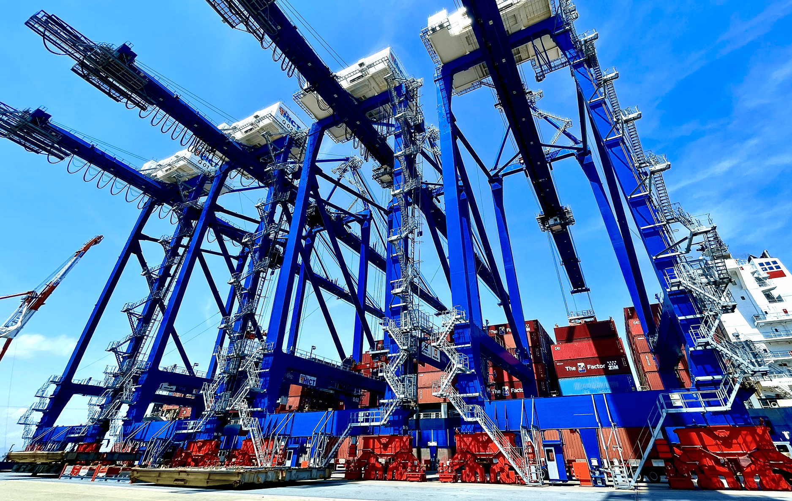
TAN CANG
HAI PHONG INTERNATIONAL
CONTAINER
TERMINAL
The First Deep-Water Container Terminal
in Northern Vietnam
Presentation Materials -ver.3
Contents : Vietnam’s Trade & Container Throughput (2-3)
Lach Huyen Port Project (4-5)
About TC-HICT (6-11)
Container Shipping in Hai Phong (12-16)
Affiliated Services (17-18)

Slide 3
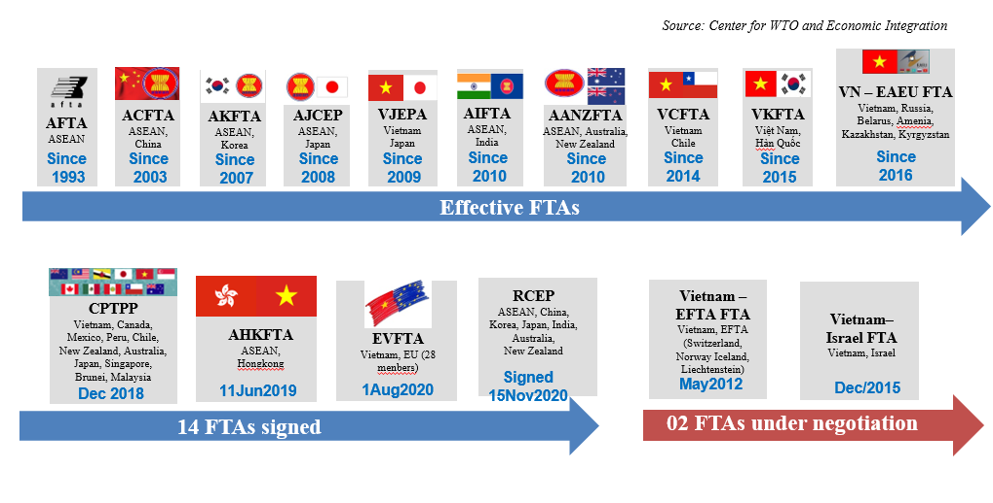
Vietnam’s GDP Growth & International Trade Turnover 2011- 2022
3
VIETNAM boosts international trades by FTA
Annual GDP Growth Rate (%)
Int’l Trade Turnover (Billion USD)
May 23

Slide 4
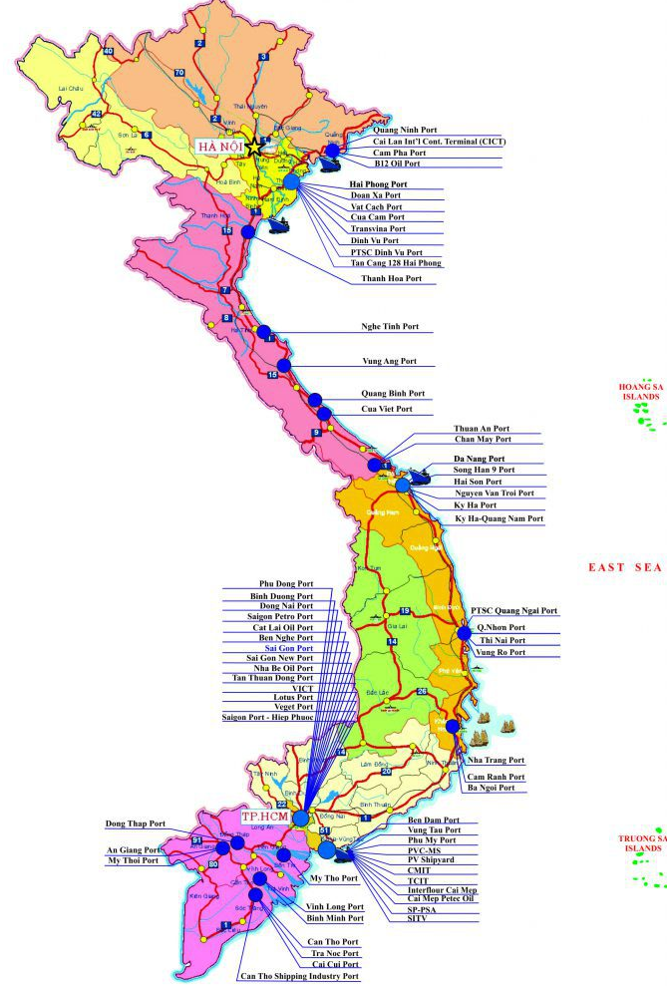
Container Throughput in Vietnam by region (International + Domestic)
4
(Source: VPA, SNP-MKT, TCIT & HICT)
Notes:
Looking at the red colour section on the bar chart, we can see that Cai Mep – Thi Vai port range’s throughput volume is rapidly increasing since the very first day came into operations in 2009

Slide 5
Lach Huyen Port Project – Starting Phase
5
The first Public-Private Partnership “PPP” project between VIETNAM and JAPAN
Construction / Investment | Contractor | Completion
#1. Tan Vu - Cat Hai Bridge & Access Road (Rd 4.50km+Brdg 5.44km+Rd 5.69km total 15.63km) | SMCC-Local JV | 2017-Sep
#2. Port Area Development (land reclamation, soil improvement, retaining wall, public berth, etc.) | Penta-Toa JV | 2017-Nov
#3. Dredging up to -14.0m Channel (L 17.1km x W 160m) & Turning Basin (Φ660m) | Toyo / Penta-Rinkai JV | 2018-Aug
#4. Breakwater (2.5km) & Sand Protection Dyke (7.6km) | Toa | 2019-Nov
#5. Main Berth 750m + Ship to shore crane x 6, Barge Berth 150m + Fixed crane x 2, Container Yard, Truck Gate, Maintenance Shop, Office, Canteen, Parking, Fuel Station, etc. | Selected by HICT | Jul-2018
#5
#4
#1
#3
#2
#5 Main Berth
#5
The Government of Vietnam (Public sector), invested approx. USD 1.1 billion for Lach Huyen New Port – starting phase with financial support from Japanese ODA loan applied to the construction item in the table right #1 to #4
Private sector, HICT, invested USD 275 million for all the port infrastructures, facilities, container handling equipment, IT system and everything required to build and to operate the container terminal on the leased area for the berth No.1&2

Slide 6
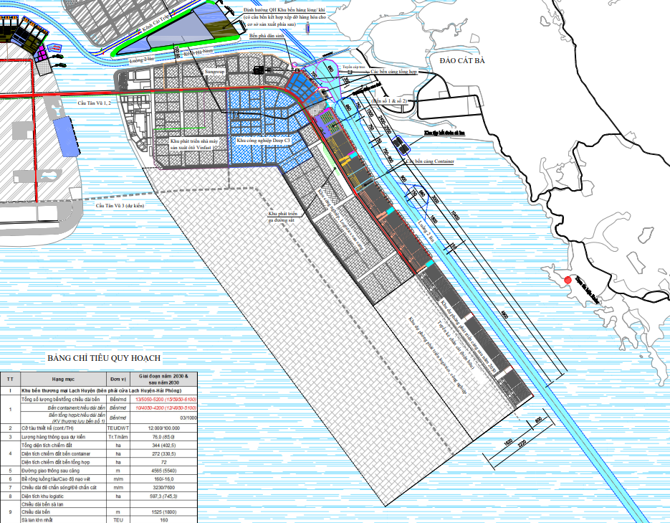
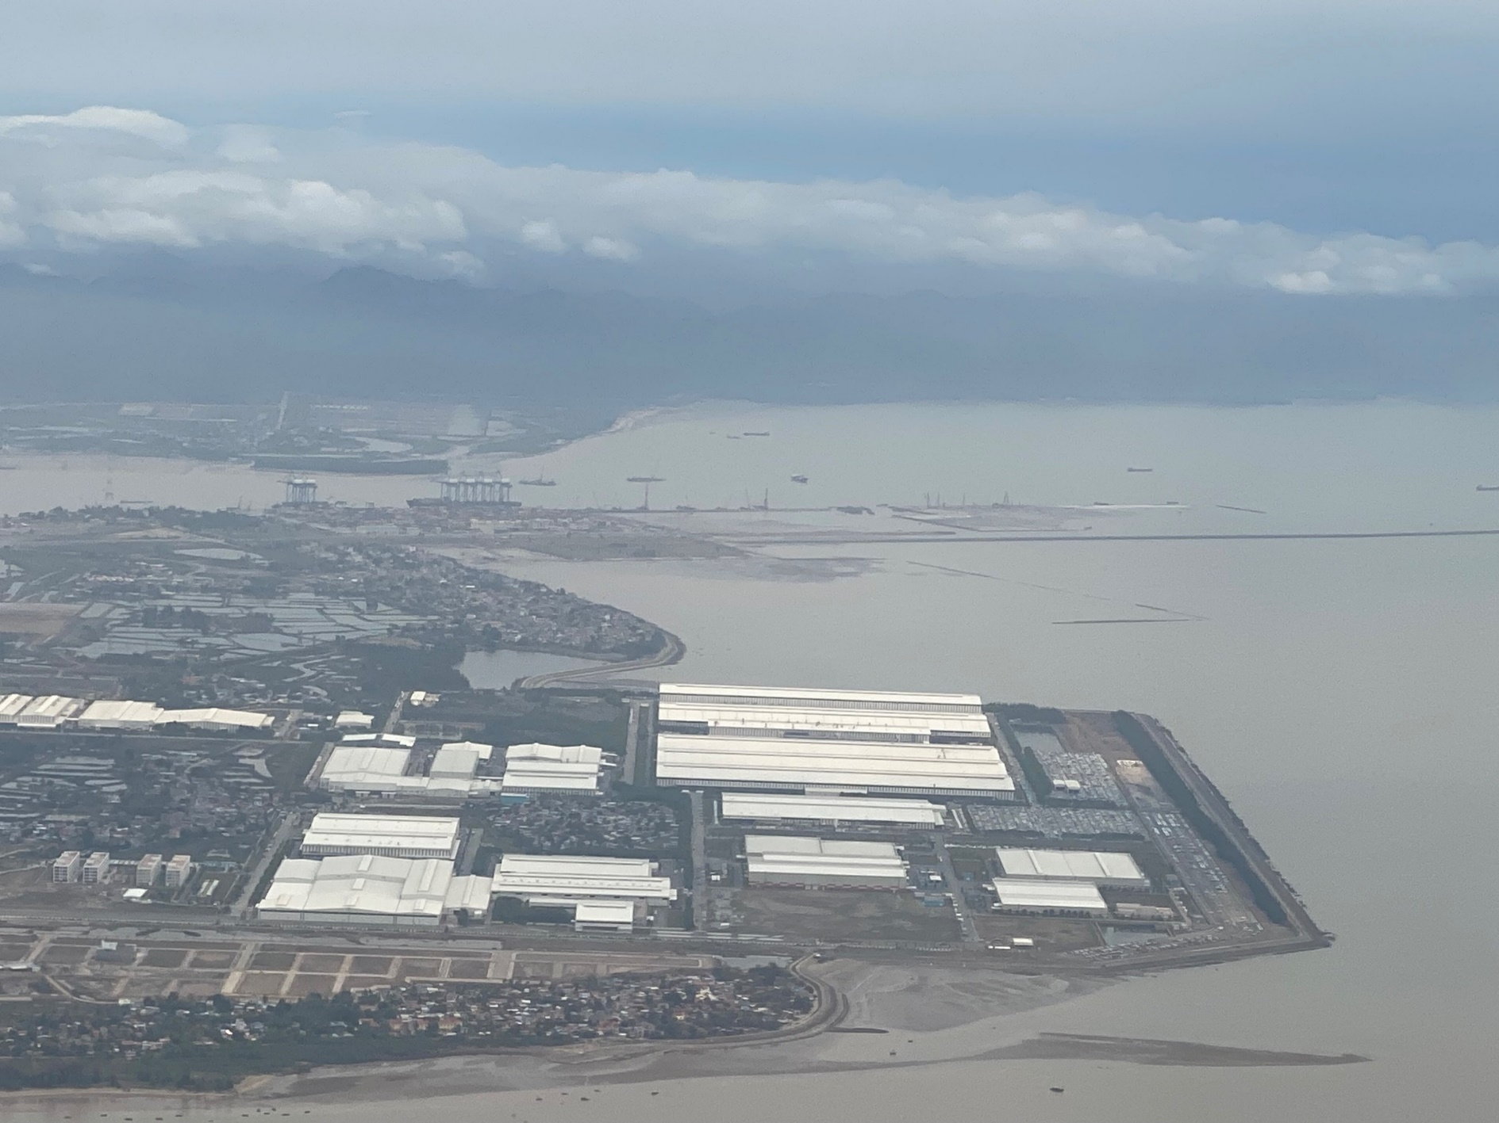
Lach Huyen Port Master Plan – Container Terminals
6
Berth 1&2
Berth No.3 to 6 are under construction ( 2022 – 2025 )
Berth 3&4
VINFAST
DEEP C III
Berth 5&6
Lach Huyen Port area - bird view
SNP
Berth 7 & 8
Investment certificate to SNP issued on 9/May/2023, construction will start in 2024
(Berth 3&4)
(Berth 5&6)
TC-HICT
(DEEP C III)
VINFAST
10:49 11 Oct. 2022
29/Mar/2023

Slide 7
TC-HICT Corporate Profile
7
History
2011
Established, 1st Certificate of Incorporation was issued
(Original investors: VINALINES 51%, MOLNYKITO 49%)
2013 Vietnamese investor was replaced to SNP
2016
Ground Breaking Ceremony - 12th May
WHL took NYK Line’s share over (MOLNYKITO was dissolved)
2018
Opening Ceremony - 13th May
2019
a 132,900 DWT vessel called on 7th May
2022
Annual throughput exceeded the designed capacity, 1.1million TEU
Authorized max size of vessel extended to 145,000 DWT
SNP: Saigon Newport Corporation
MOL: Mitsui O.S.K. Lines, Ltd.
WHL: Wan Hai Lines Ltd.
ITO: Itochu Corporation

Slide 8
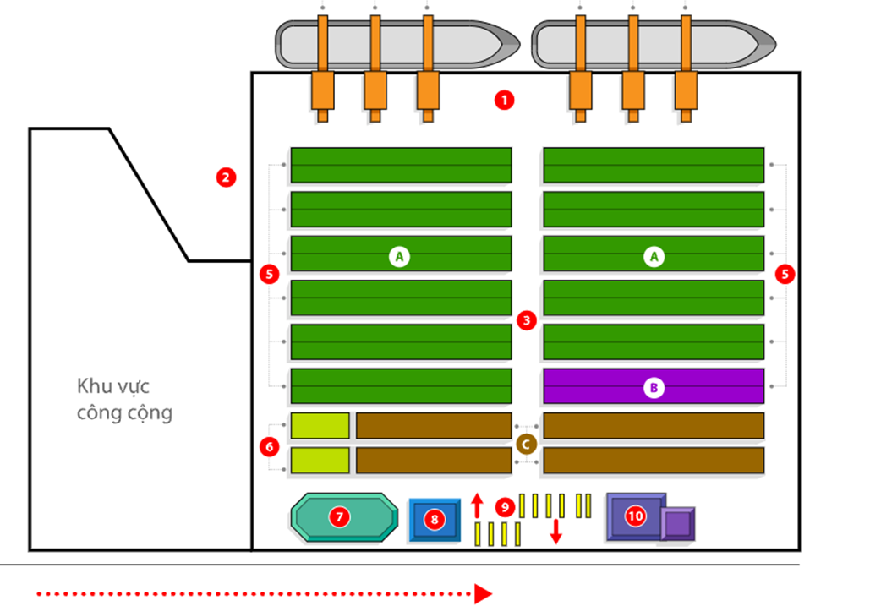
TC-HICT Terminal Facility & Equipment
8
Terminal Layout
Berth No.1
Berth No.2
Total Area: 57ha
Designed Throughput Capacity: 1,100,000 TEU/year
Container Storage Capacity: 35,660 TEU
Largest Vessel Size Approved by VINAMARINE: 145,000 DWT
Main Berth: length 750m, original depth -16.0m*
Barge Quay: length 150m, original depth -5.0m*
Container Handling Equipment (CHE) lineup:
Public Area
6D
6E
1. Main Berth 750m x 50m
2. Barge Berth 150m x 30m
3. Center Road
5. Container Storage
A: Dry：22 lanes +eRTG
B: Reefer：2 lanes +eRTG
6. Container Storage
C: Empty
D: Oversize, IMDG
E: Customs Inspection Area
7. Equipment Maintenance shop
8. Container M&R shop
9. Truck Gate
10. Office & Canteen
06 STS cranes
30 trucks & chassis
24 eRTG
03 Reach Stackers
720 Reefer plugs
Additional CHE purchase plan in 2023 to 2024
+ 02 STS cranes / + 15 Trucks & Chassis / + 02 Reach stackers / + 02 Empty Handlers
* Actual depth become shallower due to sedimentation continuously flow in to the area

Slide 9
TC-HICT Capacity & Advantage
9
No. | Items | TC-HICT | River Terminals | Remarks
 | Facility
1 | Channel Depth | - 11.6m (#1) | - 7.0m
2 | Berth Front Depth | B1-10.6m / B2-11.3m (#2) | - 7.5m
3 | Turning Basin Diameter | 660m | 250-350m
 | Ship to Shore Crane
4 | Outreach | 65m | < 40m
5 | Lifting height above rail | 46m | < 36m
6 | Lifting capacity | 65MT (2x20’ twin) | 50MT
 | Vessel Operation
6 | Largest size | 13,000** TEU (#3) | < 2,000 TEU
7 | Navigational condition | Tide may effect in case vessel’s draft >13m (#4) | Restricted by tide almost all
 | Service Route
8 | Main target | Long haul mother vessels | Intra-Asia Feeders, Domestic
#1 original depth -14.0m
MOT committed to maintain Lach
Huyen channel depth at 13m
#2 original depth -16.0m
Restored to -14.0m in Jan-2022
As of Feb-2023:
B1 -10.6m / B2 -11.3m
#3 up to 145,000dwt
TC-HICT will try to get approval
up to 160,000dwt
#4 depends on the actual depth at the
channel and the berth front area

Slide 10
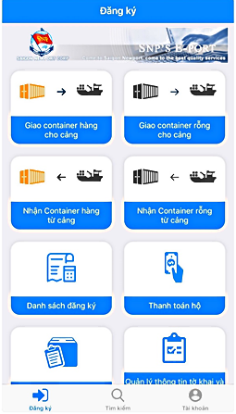
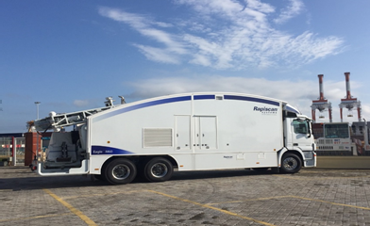
TC-HICT - IT Function / Container scanner
10
Advantage – IT System
https://eport.saigonnewport.com.vn
TOPS
(Terminal Operations Package System)
architected by RBS, Australia
Integrated to e-Customs (Declaration via Internet, Submission of Manifest by EDI)
Linked with X-ray container scanner for the Customs inspection
Link with e-banking
100% online procedure by EPORT for both inbound & outbound containers
More than 18 shipping lines have used electronic delivery orders (EDO)
Real-time Container Location Report
Wireless Devices. Hand-held, DGPS
Auto Planning of Shipside & Container Yard
Container Handling Equipment Assignment
Container Scanner
High-energy mobile scanners designed for non-intrusive inspection of cargo
Available for various cargo inspection without opening the containers

Slide 11
TC-HICT Pro-forma Berth Window
11
Sun | Mon | Tue | Wed | Thu | Fri | Sat
PN2
PS3
SEN
ZXB
CYH
AA3
CI3
CBX
AAC
TPX
BBX3
RWA1
ORCHID
SANTANA
AA9
CBX2
CI7
No | Service | Operator | Vessel size (Teu) | Port Rotation
1 | PN2 | THEA | 8,500-10,000 | HICT-YTN-Tacoma-VAN-KAO-SIN-LCB-SSIT
2 | PS3 | THEA | 8,500-10,000 | HICT-LGB-OAK-PUS-SHA-NBO- Shekou- SIN- PKL- Nhavasheva– Pipavav- CLB- PKL- SIN- LCB- TCIT
3 | TPX | MAERSK | 6,000 | HICT- YTN- NBO- Los Angeles
4 | AA3 | WHL | 6,000-13,000 | HICT – KAO – HKG – YTN – LGB
5 | AAC | COSCO | 10,000 | HICT – Xiamen – Ningbo – Long Beach – Oakland – Cai Mep
6 | SANTANA | MSC | 6,000 | HICT-SHA-NBO-Charlestown-New York
7 | SENTOSA | MSC | 7,000 – 8,000 | HICT-Long Beach-Oakland-Busan-Laem Chabang-Vung Tau
8 | ZXB | ZIM | 7,000 | HICT- Yantian– Kao– Kingston– Baltimore– Norfolk– New York– Boston– Jakarta– LCB– Cai Mep
9 | CBX | CMA-CGM | 10,000 | HICT- Yantian- Ningbo- Shanghai- Busan- Yokohama- Norfolk- Savannah- Charleston- Mianmi
10 | CYH | COSCO | 4,300 | HICT-XianChan Beach-HKG-Tianjin-QDA-LianYunGang- Ningbo-FuZhou
11 | CI3 | WHL/COS/OCL/ONE | 4,500 | HICT-SHA-NGB-HKG-SHK-SIN-PKL-MAA-KAT-PKL-SIN
12 | ORCHID | MSC | 3,500 | HICT-Qinzhou-YTN-HKG-QDA-Fuzhou-Shantou-HKG-Shekou-HICT-Tanjong Pelepas-SIN-Shekou
13 | BBX3 | CMA-CGM | 2,200 | HICT- Nansha- Hong Kong– Shekou– Singapore– Chittagong– Singapore- Danang
14 | CI7 | WHL | 1,700 | HICT-Qingdao - Shanghai - Ningbo - Nansha – PKL- Cochin - Nhavasheva - PKL- LCB
15 | CBX2 | SITC | 1,800-2,600 | HICT- PKL- Chittagon- Penang-PKL- Kuatan- HCMC- Xiamen- Wenzhou- Inchon
16 | RWA1 | RCL/PIL/CUL/IAL | 2,500 | HICT- Nansha - Shekou - Singapore - PKL- Nhava Sheva - Mundra - PKL

Slide 12
TC-HICT – Container Throughput Analysis
12
Unit: 1,000 TEU
2022 Trade x Laden/Empty Volume Share
STS Crane: 2 units only
Berth front depth < -10m
USA+Canada total 698,541 teu, 59.1% |  |  |  | Intra-Asia total 418,894 teu, 35.5% |  |  |  | others
US Imp-L | US Imp-E | US Exp-L | US Exp-E | IA Imp-L | IA Imp-E | IA Exp-L | IA Exp-E
8.9% | 19.4% | 30.2% | 0.6% | 16.8% | 3.5% | 13.1% | 2.0% | 5.4%
105,520 | 228,740 | 356,843 | 7,438 | 198,927 | 41,339 | 154,938 | 23,690 | 64,041
Year | 2018 | 2019 | 2020 | 2021 | 2022 | 2023 Jan-Apr | Accumulated
Total (1000TEU) | 65 | 419 | 662 | 697 | 1,181 | 325 | 3,349
Annual Growth | - | 545% | 58% | 5% | 70% | -2.5% Y-o-Y
2018 – 1Q2023 Accumulated

Slide 13
Container Throughput in Hai Phong – transitional & breakdown
13
Unit: 1,000 TEU
Yearly Growth Average: 9%
Unit: TEU
 | 2022 | 2021 | yearly growth
Inbound Int'l Laden | 2,214,590 | 2,055,137 | 159,453 | 7.8%
Inbound Int'l Empty | 497,798 | 353,629 | 144,169 | 40.8%
Inbound Domestic Laden | 360,490 | 441,749 | (81,259) | -18.4%
Inbound Domestic Empty | 88,423 | 29,713 | 58,710 | 197.6%
Outbound Int'l Laden | 2,169,913 | 2,039,663 | 130,250 | 6.4%
Outbound Int'l Empty | 463,504 | 338,813 | 124,691 | 36.8%
Outbound Domestic Laden | 362,849 | 381,917 | (19,068) | -5.0%
Outbound Domestic Empty | 50,831 | 55,227 | (4,396) | -8.0%
Inbound Volume Total | 3,161,301 | 2,880,228 | 281,073 | 9.8%
Outbound Volume Total | 3,047,097 | 2,815,619 | 231,478 | 8.2%
Haiphong Port Total | 6,208,398 | 5,695,847 | 512,551 | 9.0%

Slide 14
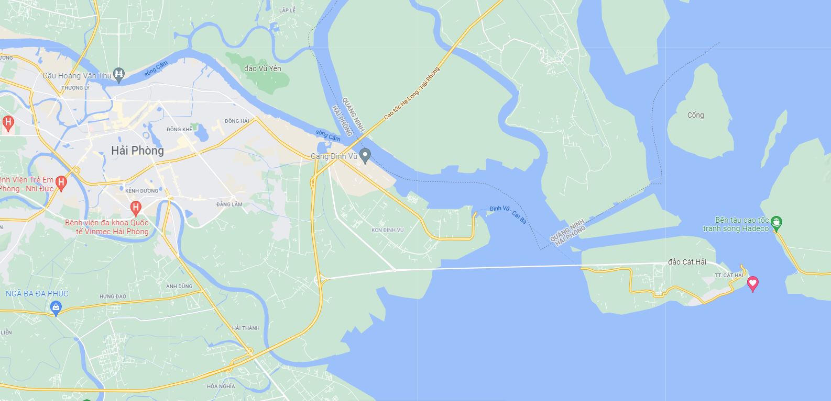
Container Terminals in Hai Phong + throughput volume in 2022
14
Nam Hai Port
SNP (3 terminals)
Chua Ve
GMD (3 terminals)
1
2
3
TC 128
VICONSHIP (3 terminals)
4
PTSC Dinh Vu
Hai An Port
VINALINES (6 terminals)
Doan Xa
5
6
Dinh Vu Port
OTHERS
Transvina
7
Nam Hai Dinh Vu
Green Port
8
9
10
11
Mipec
VIMC
Nam Dinh Vu
Unit: TEU
16
TC 189
12
13
14
15
Tan Vu Port
16
VIP Green Port
17
17
17
12
14
13
11
7
16
6
9
Sources: VPA & SNP

Slide 15
Exports & Imports through Hai Phong 2021 & 2022
15
 | Export |  | Import |  | Annual Growth in 2022 (TEU, %) |  |  |  | Trade volume balance Exp-Imp
 | 2021 | 2022 | 2021 | 2022 | Export |  | Import |  | 2021 | 2022 | 22-21
China | 338,584 | 336,337 | 680,250 | 728,600 | (2,247) | -0.7% | 48,350 | 7.1% | (341,666) | (392,263) | (50,597)
ASEAN | 175,411 | 197,462 | 254,837 | 292,326 | 22,051 | 12.6% | 37,489 | 14.7% | (79,426) | (94,864) | (15,438)
Korea | 132,578 | 138,874 | 347,318 | 383,124 | 6,296 | 4.7% | 35,806 | 10.3% | (214,740) | (244,250) | (29,510)
Japan | 122,380 | 141,044 | 139,749 | 143,948 | 18,664 | 15.3% | 4,199 | 3.0% | (17,369) | (2,904) | 14,465
India | 30,774 | 46,530 | 36,698 | 43,729 | 15,756 | 51.2% | 7,031 | 19.2% | (5,924) | 2,801 | 8,725
other Asia | 183,390 | 174,801 | 220,195 | 246,383 | (8,589) | -4.7% | 26,188 | 11.9% | (36,805) | (71,582) | (34,777)
USA | 583,343 | 640,125 | 94,536 | 88,584 | 56,782 | 9.7% | (5,952) | -6.3% | 488,807 | 551,541 | 62,734
other America | 110,142 | 108,496 | 59,599 | 68,652 | (1,646) | -1.5% | 9,053 | 15.2% | 50,543 | 39,844 | (10,699)
EU | 242,720 | 269,069 | 104,812 | 95,227 | 26,349 | 10.9% | (9,585) | -9.1% | 137,908 | 173,842 | 35,934
other Europe | 67,309 | 56,418 | 32,882 | 26,575 | (10,891) | -16.2% | (6,307) | -19.2% | 34,427 | 29,843 | (4,584)
Oceania | 31,615 | 39,058 | 54,461 | 68,652 | 7,443 | 23.5% | 14,191 | 26.1% | (22,846) | (29,594) | (6,748)
Africa | 21,416 | 21,699 | 29,799 | 28,790 | 283 | 1.3% | (1,009) | -3.4% | (8,383) | (7,091) | 1,292
Total | 2,039,662 | 2,169,913 | 2,055,136 | 2,214,590 | 130,251 | 6.4% | 159,454 | 7.8% | (15,474) | (44,677) | (29,203)

Slide 16
Container Carrier Ranking in Hai Phong 2022
16
UNIT: 1000 TEU
Rank 2022
(2021)

Slide 17
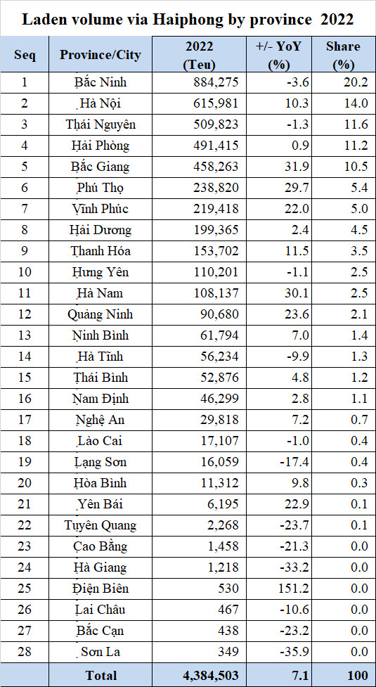
Container volume through Hai Phong by Provinces2022
17
Note:
Top 12 share total 93%

Slide 18
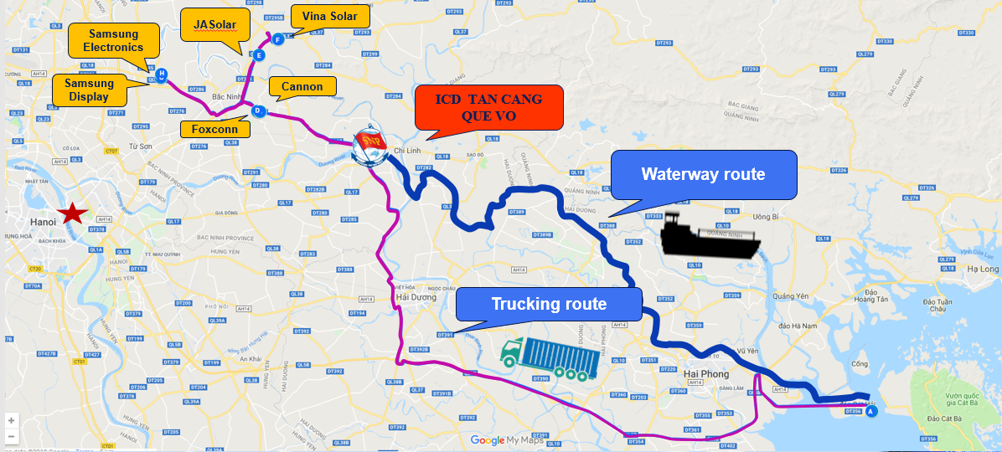
SNP – ICD Tan Cang Que Vo in Bac Ninh Province
18
Location | Chau Phong IZ
Total Area | 27 ha
Designed Capacity | 400,000 TEU p.a.
Quay Length/Depth | 360 m (3 berths), -5m
Warehouse (CFS) | 6,000 m2
Container Handling Equipment (CHE) | Fixed Quayside Crane x3, RTG x2, Reach Stacker x2, Truck x 20, Reefer plugs x72
Distance from HICT | 115km by waterway
Transit time | 9 hours
Distance from major manufacture
Samsung Display | 34.0 km
Samsung Electronics | 32.8 km
Cannon | 16.7 km
Foxcon | 16.2 km
Vina Solar | 26.6 km
JA Solar | 30.3 km

Slide 19
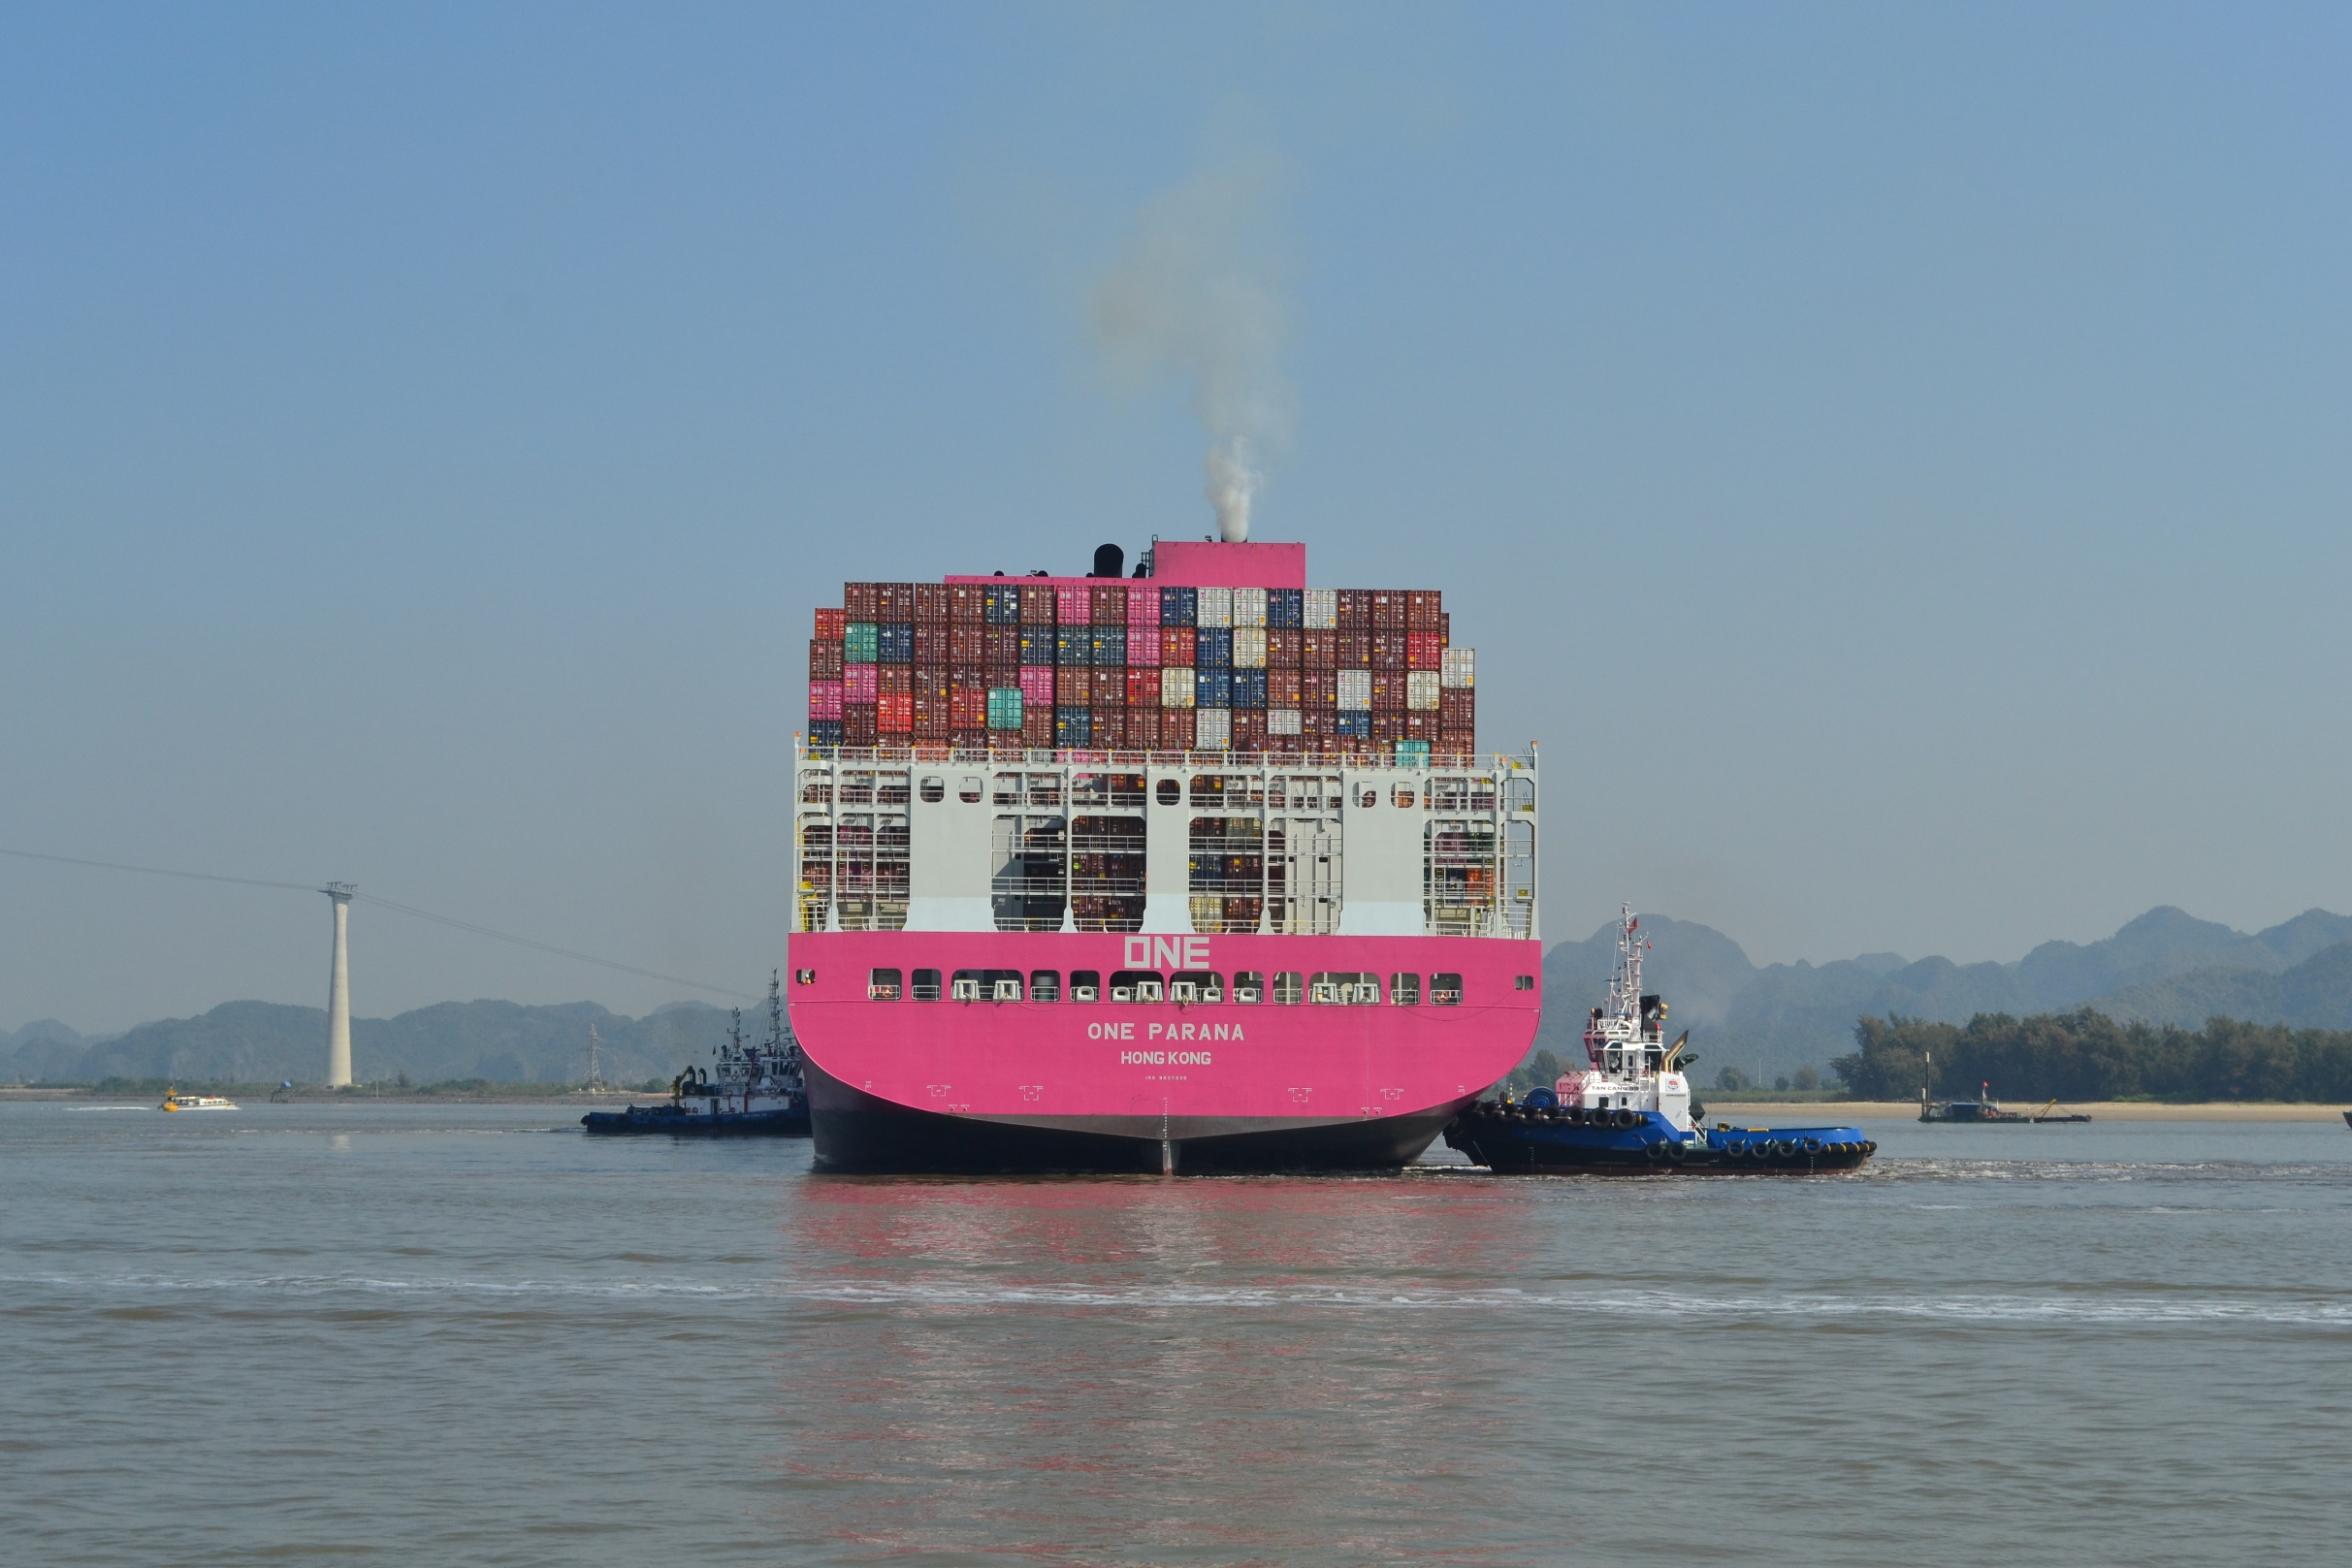
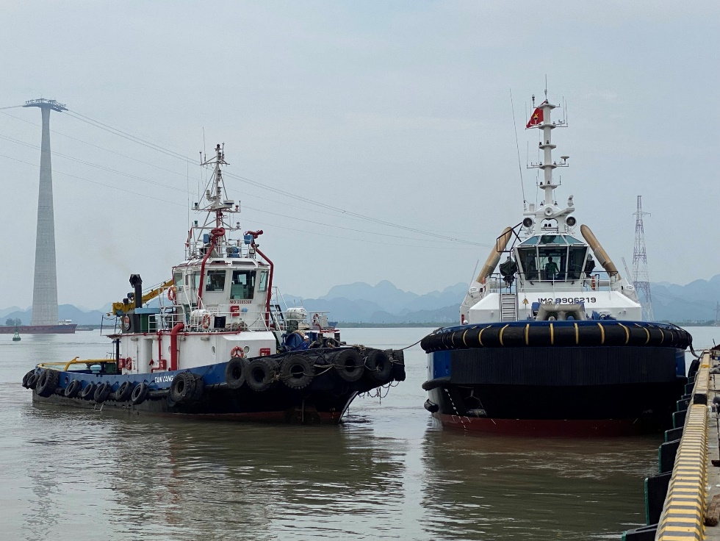
Harbor Tug Fleet to assist container vessels in Lach Huyen
19
Name of Tugboat | Main Engine output | Bollard-pull power
Tan Cang 99 | 6,772 BHP | 82 ton
Tan Cang 86 | 5,600 BHP | 68 ton
Tan Cang 62 | 4,000 BHP | 58 ton
Tan Cang A18 | 3,600 BHP | 45 ton
Tan Cang Northern Maritime provides tug assistance service for the vessels berthing, unberthing and turning at Lach Huyen port

Slide 20
EMAIL
mkt@hict.net.vn
csv@hict.net.vn
WEBSITE
www.hict.net.vn
HOTLINE
1800 9270
THANKS !

